Slide 1
Path Planning for Marine Surveys
34763 Autonomous Marine Robotics Course (Training)

Slide 2
Outlines
Activity 1: Test various 2D path planning methods
Activity 2: Implement 2D path planning method using ROS for BlueROV simulators
Activity 3: Test and implement 3D path planning method using ROS for BlueROV simulators

Slide 3
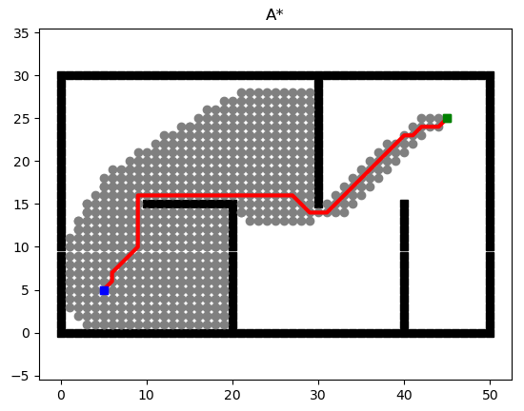
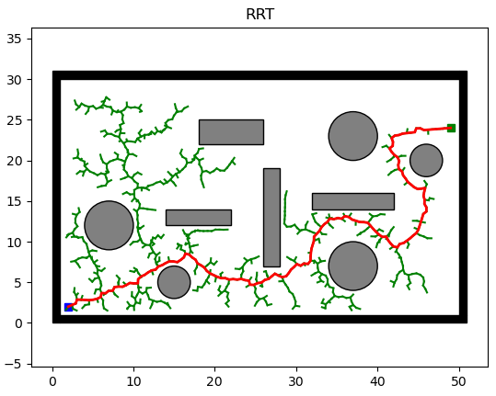
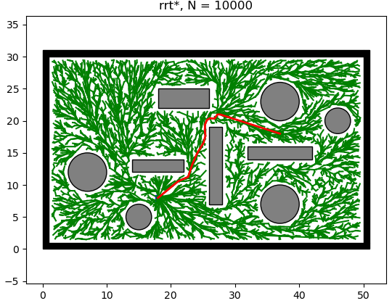
Activity 1
Fork and clone the repository: github.com/yaqub93/PathPlanning
Make sure Python 3 and the dependencies are installed:
python -m pip install -r requirements.txt
Run two search-based and two sampling-based path planning methods
Create or modify the scripts for comparison purpose. Please compare the (a) Trajectory length (b) Computation time
To ensure the repeatability, collect the metrics data for 3-5 trials

Slide 4
Activity 2
Go to the ROS workspace
Add a new python file in package ()
Implement one of the path planning method.
The helper functions for accessing the map or obstacle is available.

Slide 5
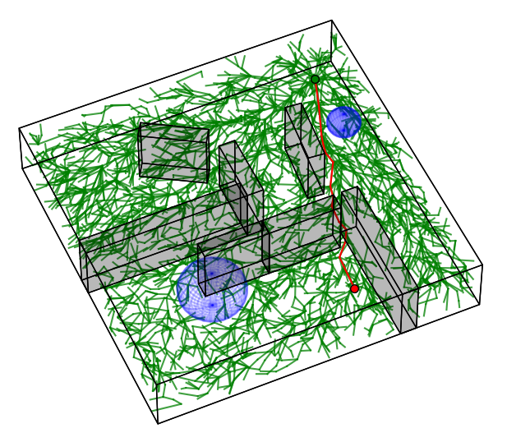
Activity 3
Repeat activity 1 and 2 but using 3D path planning methods

